Slide 1
Greetings

Slide 2
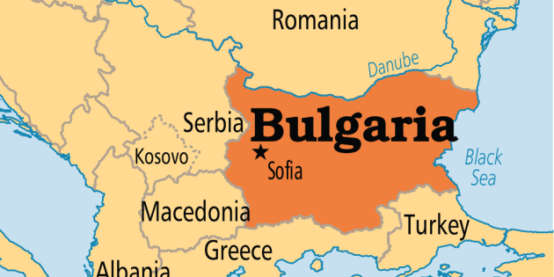
Ivaylo Radev – Ивайло Радев
IICT-BAS

Slide 3
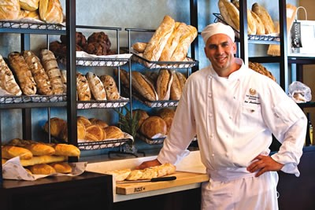
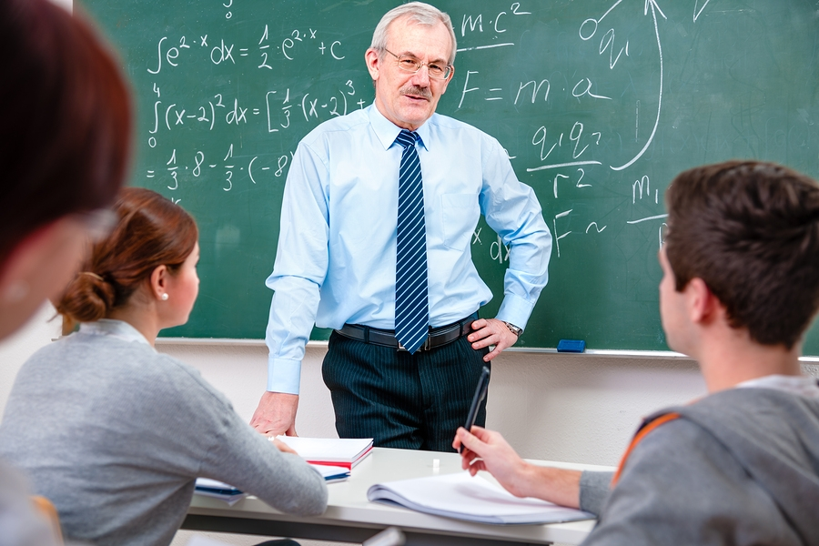
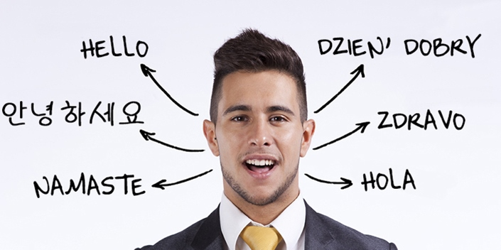
Background (1)

Slide 4
Background (2)
In the field of NLP since 2011
Manual data
  Alignment
  Translation
  Annotation

Slide 5
Background (2)
In the field of NLP since 2011
Manual data
  Alignment
  Translation
  Annotation

Slide 6
Current work (1)
BTB-WN since 2014
CWN
BG lemma – sense, examples, mapping

Slide 7
Current work (1)
BTB-WN since 2014
CWN
BG lemma – sense, examples, mapping

Slide 8
Current work (2)
Creation of golden standard for IE in clinical texts since 2017

Slide 9
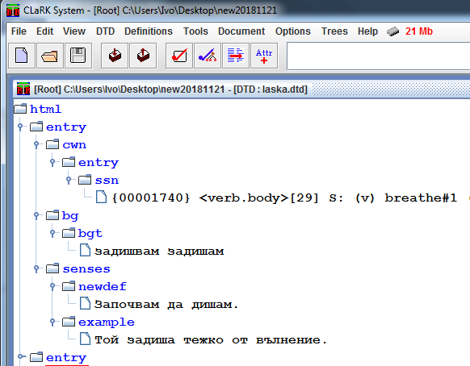
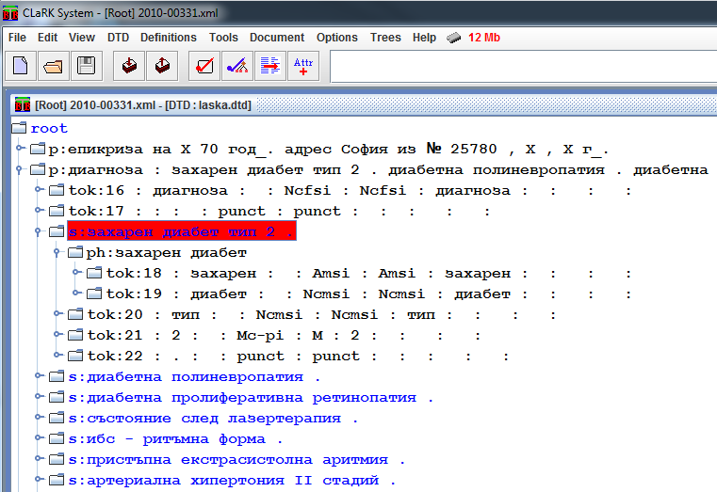

Slide 10
CLaRK
XML editor
  XML Engine and Editor
  Unicode
  Document Transformation
  Tokenizer
  Constraints over XML Documents
  Regular Cascade Grammars

Slide 11
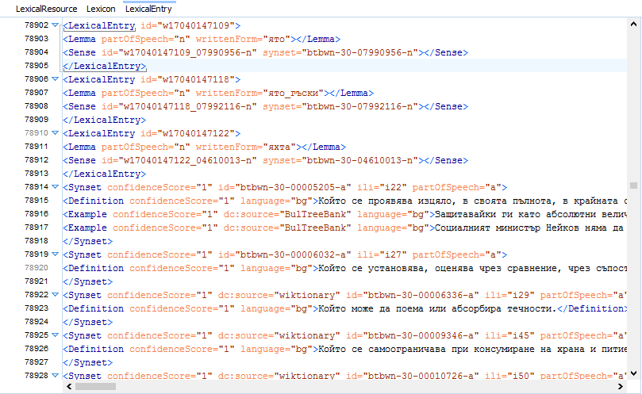
Data
Current BTB-WN

Slide 12
Goals
TEI
Oxygen

Slide 13
Thank you!

Slide 14
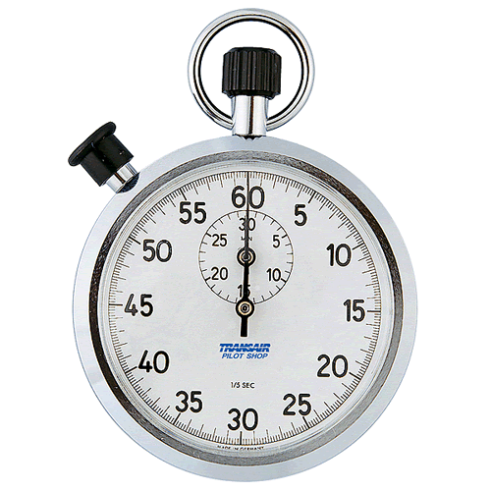
Time’s Up!
About your speaker:
  Name: Ivaylo Radev
  Institution: IICT-BAS
  Social Media: Fb
  Quick bio: Hard working language resourses guy since 2011

